Slide 1
A Novel Efficient Graph Model for the Multiple Longest Common Subsequences (MLCS) Problem
Zhan Peng and Yuping Wang,
School of Computer Science and Technology, Xidian University,
Xi’an, China,
Frontiers in Genetics, volume 8, 2017
Presenter: Zhi-Cheng Shen
Date: May.02, 2023

Slide 2
Abstract
Measuring the similarity of biological sequences is a fundamental problem in bioinformatics, which has many applications such as in cancer diagnosis (Aravanis et al., 2017) and detection of the species common origin (Zvelebil and Baum, 2007), etc. One of the most important ways to measure the similarity of sequences is to find their Longest Common Subsequences (LCS), which has been proved to be a NP-hard problem (Maier, 1978). According to the number of sequences, the problems are classified into two cases: (1) Looking for the longest common subsequence of two sequences is called the Longest Common Subsequence (LCS) problem. (2) Looking for the longest common subsequence of more than two sequences is called the Multiple Longest Common Subsequences (MLCS) problem.

Slide 3
Abstract
Traditionally, the works are mainly focused on the first kind of problem. However, in recent years, more and more applications in bioinformatics (and many other fields) require to look for the longest common subsequence of many sequences. For example, one of the most important applications of the MLCS algorithms in bioinformatics is multiple sequence alignment (MSA), which is an essential technique of arranging the sequences of DNA, RNA, or protein to identify regions of similarity that may be a consequence of functional, structural, or evolutionary relationships between the sequences.

Slide 4
Abstract
The MLCS algorithms can also be used for other types of sequences, such as calculating the edit distance cost between strings in a natural language or in financial data. Although there are algorithms proposed for these applications, they are not efficient enough for many and long sequences due to their high time and space overhead.
In this paper, we propose a new time and space efficient graph model called the leveled directed acyclic graph (Leveled-DAG for short) and design the corresponding algorithm to construct it. The Leveled-DAG is constructed level by level, which is similar to the construction of DAG in the existing dominant point based algorithms, however, the existing dominant point based algorithms have to generate a huge number of the nodes and save them all in memory, while the Leveled-DAG approach can timely eliminate all the nodes in the graph that cannot contribute to the construction of MLCS any more.

Slide 5
Abstract
At any moment, only the nodes in the current level as well as some nodes in the previous levels are saved, therefore, the Leveled-DAG is much smaller than the DAG constructed by the existing dominant point based algorithms, which can save a lot memory space. Moreover, with the progress of the construction procedure, the scale of the Leveled-DAG becomes smaller and smaller, and the final graph contains only one node (the end node) with the wanted MLCS saved in it, thus, no operations to search for them are needed, which can save a lot of running time. The experimental results show that our approach is both time and space efficient for large-scale MLCS problems with real biological sequences and performs better than the compared leading dominant point based algorithms.

Slide 6
Abstract
This paper is organized as follows: Section 2.1 introduces some preliminaries and reviews the related work. In Section 2.2, the Leveled-DAG model and its construction algorithm is presented in detail. In Section 3, we compare the performance of the proposed algorithm with that of the existing stat-of-the-art ones via experiments. At last, we summarize the paper.

Slide 7
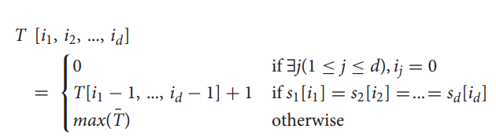
Dynamic Programming based Approaches
Time & space complexity:
O(n^{d}), d is sequence numbers

Slide 8
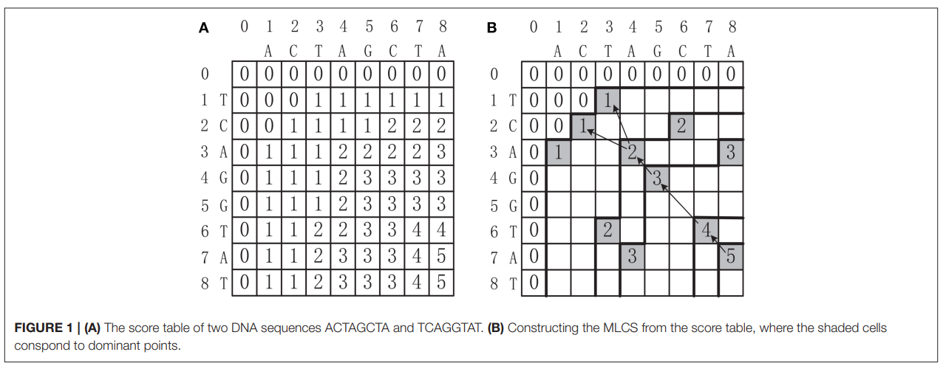
Dynamic Programming based Approaches

Slide 9
Dominant Point based Approaches
The key idea is based on the observation that only the dominant points can contribute to the construction of the MLCS.
Since the number of dominant points can be much smaller than the number of all cells in the score table T, a dominant point approach that only identifies the dominant points, without filling the whole score table, can greatly reduce the time and space complexity.

Slide 10
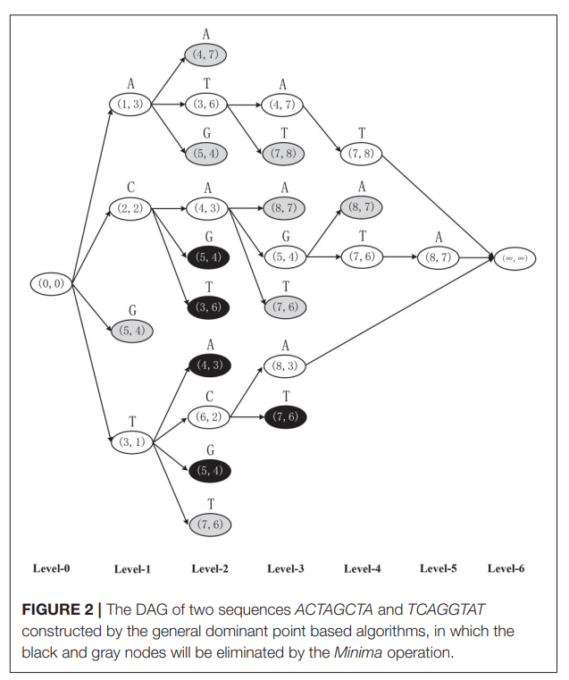
Dominant Point based Approaches
D⁰ = {(0, 0)}
D¹ = {A(1, 3), C(2, 2), T(3, 1)}
D² = {T(3, 6), A(4, 3), C(6, 2)}
D³ = {A(4, 7), G(5, 4), A(8, 3)}
D⁴ = {T(7, 8), T(7, 6)}
D⁵ = {A(8, 7)}
D⁶ = {(∞, ∞)}

Slide 11
Dominant Point based Approaches
Disadvantages:
There are a huge number of duplicated nodes and dominated nodes in each level, which consumes a lot of memory.
All these duplicated nodes and dominated nodes in each level should be deleted, and finding all these nodes in each level needs a lot of pairwise comparisons of two d dimensional vectors (while each pairwise comparison of two d dimensional vectors needs d pairwise comparisons of two integers). Thus, the deletions of duplicated nodes and dominated nodes in all levels will be very time consuming.

Slide 12
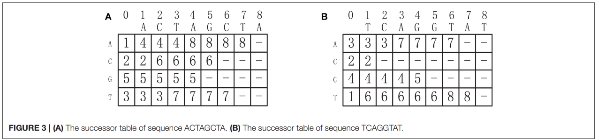
Leveled-DAG
Successor table:(key point)
String1:ACTAGCTA
String2:TCAGGTAT
∑ = {A, T, C, G}
By referring to the successor tables, given d sequences, all the successors of one node can be generated in O(d|∑|) time.

Slide 13
Leveled-DAG
Key point: once a new level of nodes are created, all the nodes in the graph with no incoming edges are outdated and will be deleted, because they can no longer be successors of any subsequent node and their partial LCSs will not be changed any more.

Slide 14
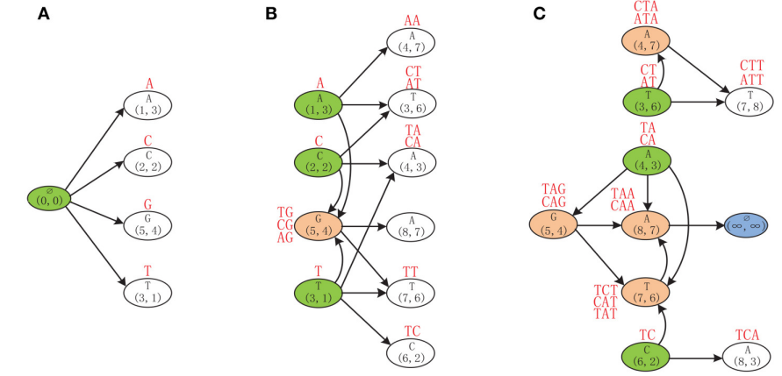
Leveled-DAG

Slide 15
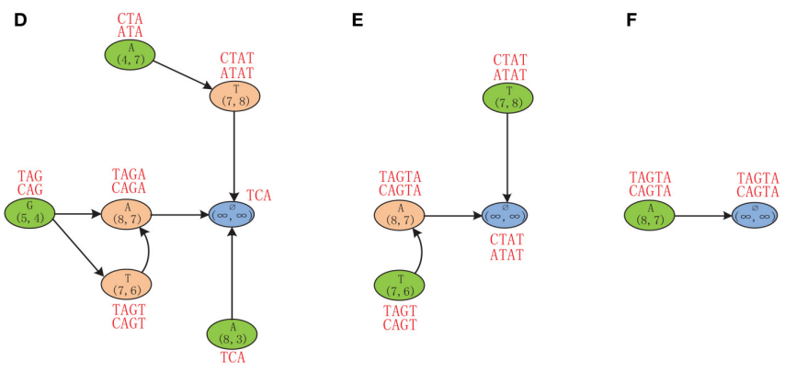
Leveled-DAG

Slide 16
Leveled-DAG
Advantages:
1.因為有了successor table的幫忙使得每個node在找successor只需常數時間即可。
2.此方法因為不會產生重複的點，所以無需額外花時間刪除重複點。
3.此方法也無須刪除dominated points。
4.此方法刪除點的方式很單純，只需在每回合判斷該點indegree是否為零，是的話刪除，不是的話保留。
5.此方法藉由每回合新增與刪除點的方式來降低space complexity
& time complexity。

Slide 17
Time Complexity
Time Complexity: (2 phases)
Build the successor table for each input sequence.
Construct the Leveled-DAG graph based on the successor tables.
Successor table: O(d | ∑| n)
Construct Leveled-DAG graph : O(2 |NODES|)
Total time complexity: O(|NODES|)

Slide 18
Space complexity
O(|Max_Level|), where |Max_Level| is the number of nodes in the max level of the graph.

Slide 19
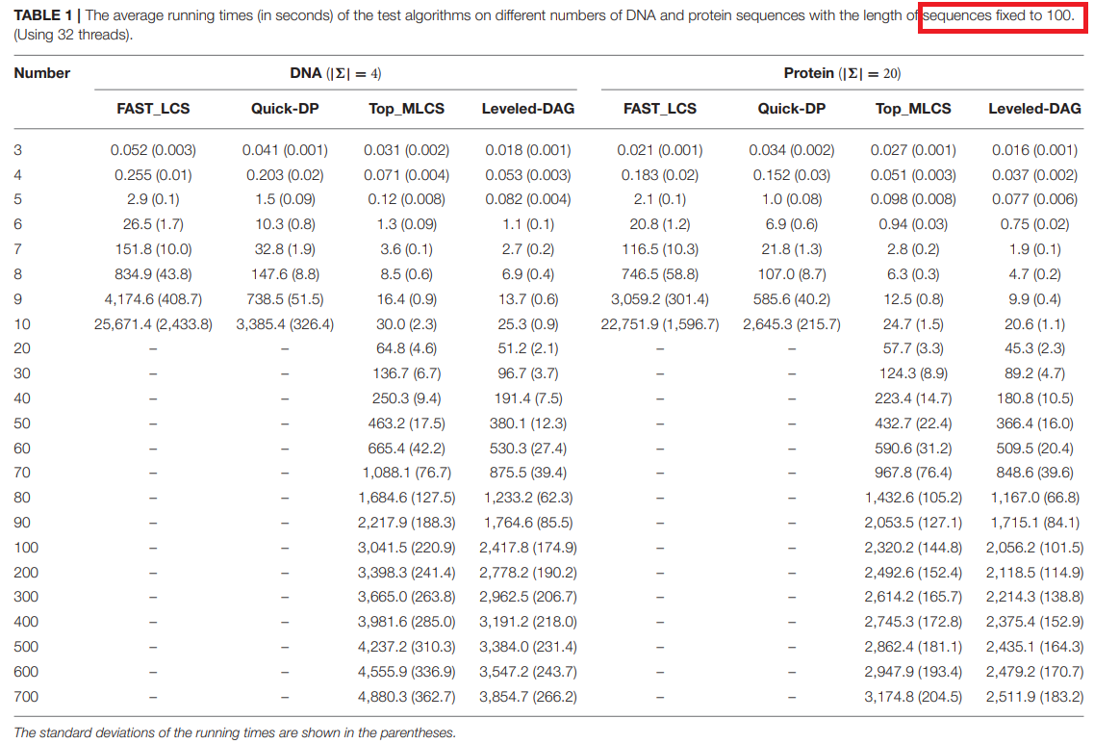
Experiment: Time

Slide 20
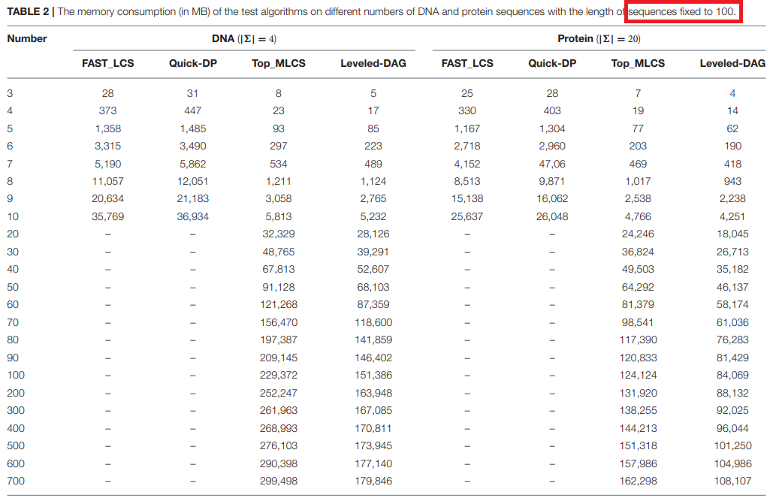
Experiment: Space

Slide 21
Thanks~

